Slide 1
IRELAND
Name yourself

Slide 2
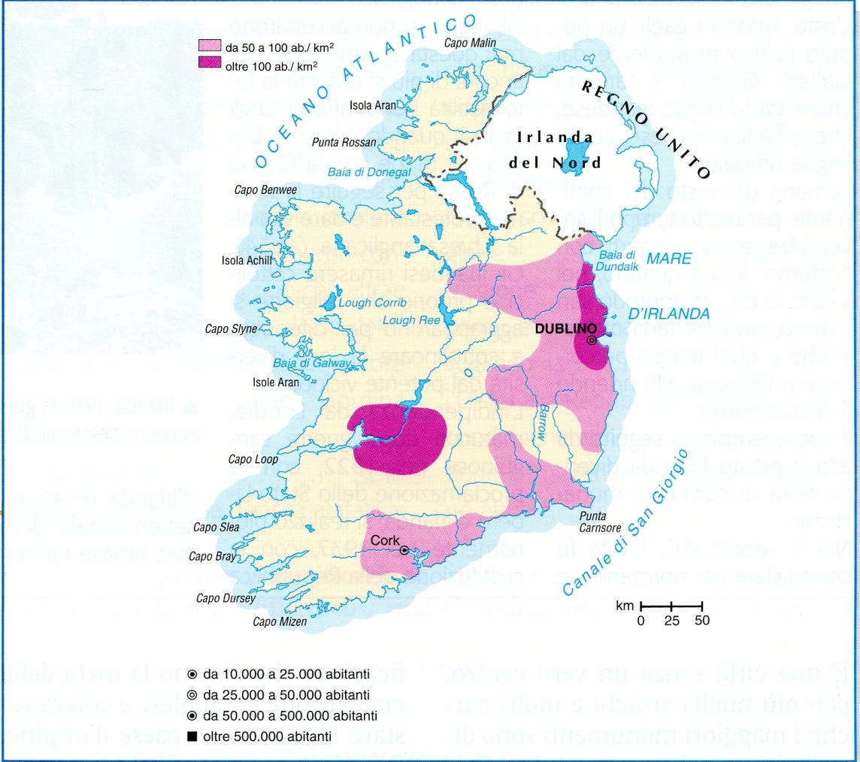
Irish population
Where does the population concentrate?

Slide 3
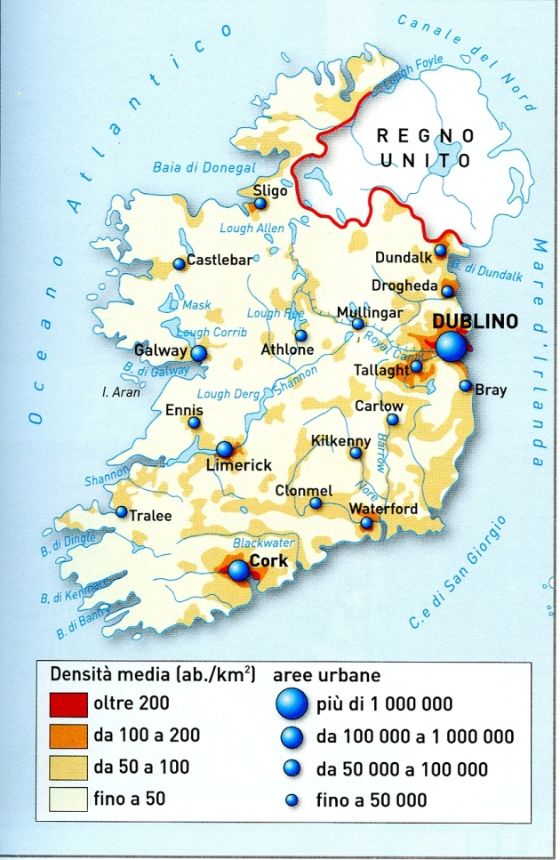
Cities
Which are the most important cities? Where are they? Find same pictures and add two or three slides

Slide 4
Social demographic data
Write short paragraphs explaining these data.

Slide 5
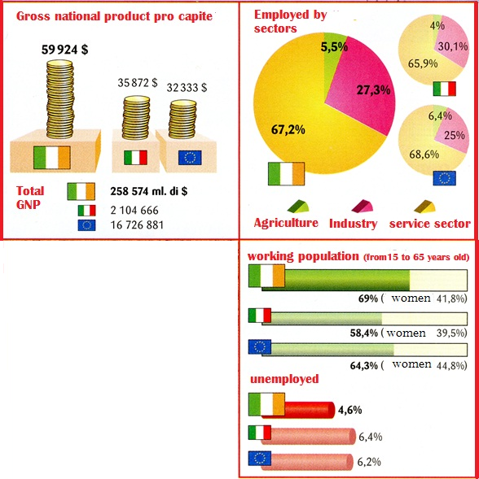
ECONOMY DATA
Write short paragraphs explaining these data

Slide 6
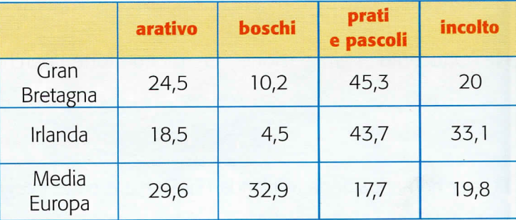
Look at the data: which sector of agriculture is likely to be the most developed in Ireland and in the UK?

Slide 7
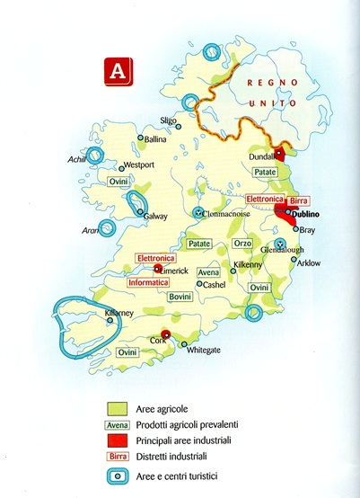
Map of Irish economy
Which are the products of Irish agriculture?
Where are the main industrial areas?
Which are the most important industrial products?
Which are the most important areas
for tourism? Find some pictures and add two or three more slides

Slide 8
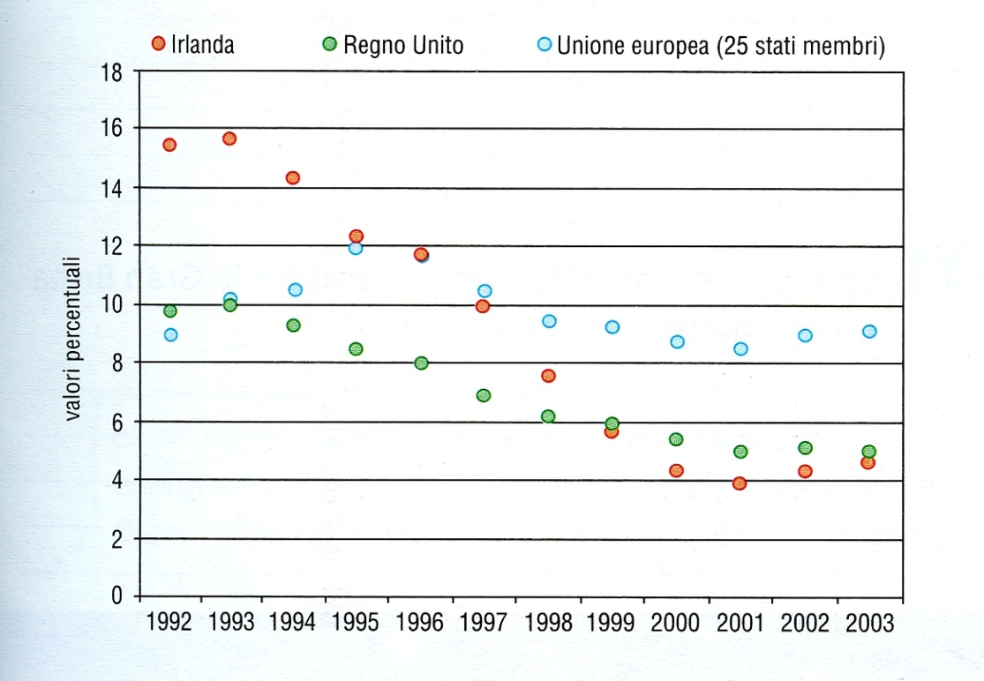
UNEMPLOYMENT
Answer the questions:
Which was the percentage of unemployment in Ireland in 1992?
When did it decrease under 10%?
Compare Irish unemployment with English and UE data

Slide 9
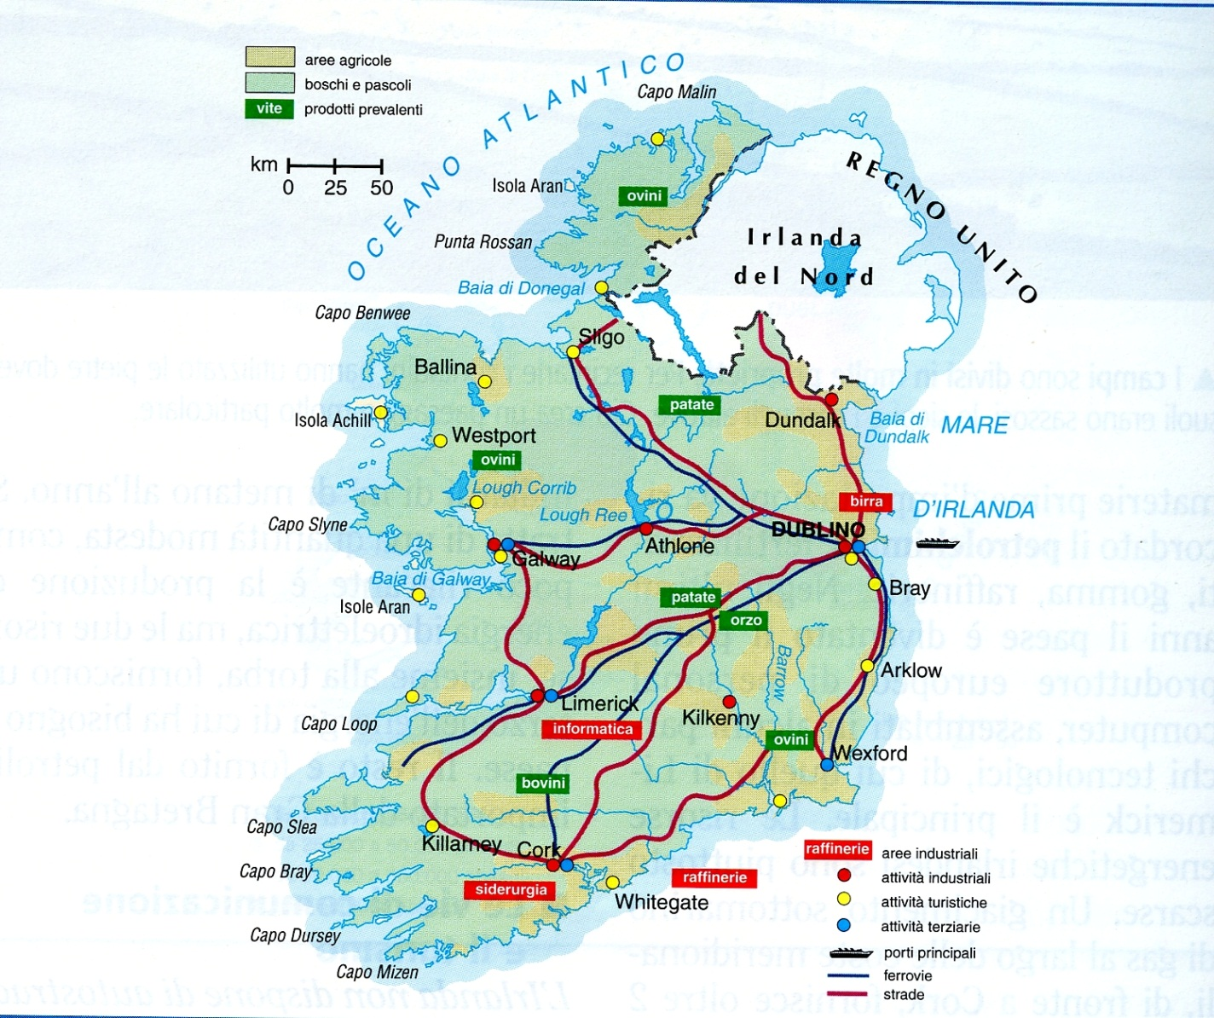
Communications
In which directiond do the main roads go? Which cities are linked?
Are there any motorways?

