Slide 1
An Italian river: Tevere, Ticino, Flumendosa, Arno, Reno, Metauro, Sele, Adda.
Insert a picture in every slide. You can find pictures in the Rivers folder.

Slide 2
The source
Look in the atlas and complete the sentences:
The source of river (Tevere) is in ………………..
River (Tevere) flows through …………………. [regions]
Search Wikipedia and answer the questions:
How large is its basin?
The basin of river (Tevere) is ……..km².
How long is the river?
The river is ……..km long.

Slide 3
The upper course
Look in the atlas and complete the sentences:
In its upper course, river (Tevere) flows through …………………. [regions] and its tributaries are ………………...
Look for some photos and select the correct information: :
In its upper part, river (Tevere) is wide/narrow, and water moves slowly/fast/very fast.

Slide 4
The middle course
Look in the atlas and complete the sentences:
In its middle course river (Tevere) flows through …………………. [regions] and its tributaries are ………………..
Look for some photos and select the correct information: :
In its middle part, river (Tevere) is wide/narrow, and water moves slowly/fast/very fast.

Slide 5
The lower course
Look in the atlas and complete the sentences:
In its lower course river (Tevere) flows through …………………. [regions] and its tributaries are ………………..
Look for some photos and select the correct information:
In its lower part, river (Tevere) is wide/narrow, and water moves slowly/fast/very fast.
There are some/There aren’t any meanders.

Slide 6
The mouth
Look in the atlas and answer:
River (Tevere) flows into …………..[sea].
Look at the picture and describe:
What can you see near the mouth?
Near the mouth I can see villages/ houses/ beaches/ boats/ ……………

Slide 7
Towns and villages
Look in the atlas and complete:
Along the course of river (Tevere) you can find……………………………… [towns or villages]

Slide 8
The flow
Look in the atlas and complete the sentence:
River (Tevere) is created from a glacier / rainfall / a lake / a dam, so its flow is larger in Spring / larger in the rainy season / depends on the dam ……………………………………………

Slide 9
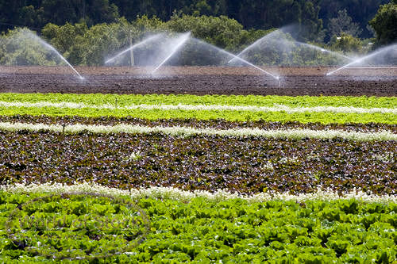
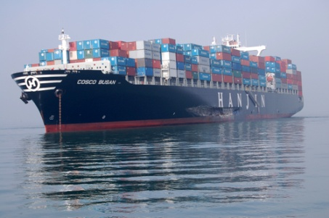
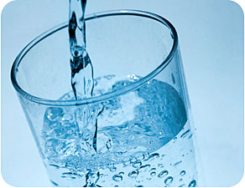
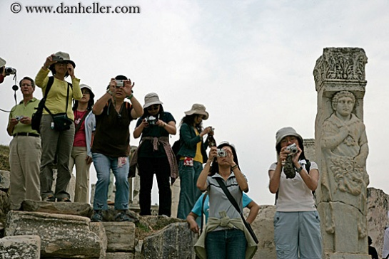
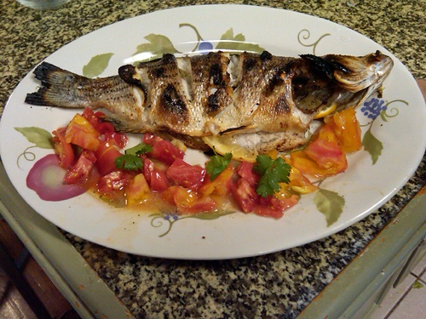
The importance of river (Tevere)
What is river (Tevere) important for? Select the right answers.
Watering crops
Transporting people and goods
Providing drinking water
Attracting tourists
Providing food

